Slide 1
Semantic Analysis

Slide 2
Semantic Analysis
From Code Form To Program Meaning
Source Code
Compiler or Interpreter
Translation Execution
Interpre-
tation
Target Code

Slide 3
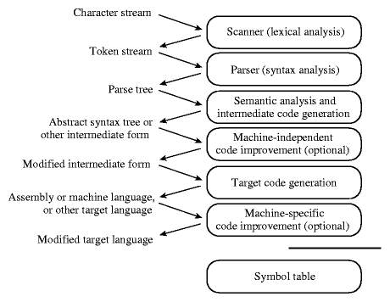
Phases of Compilation

Slide 4
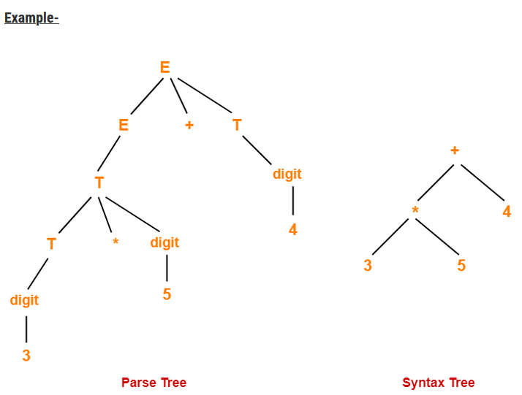

Slide 5
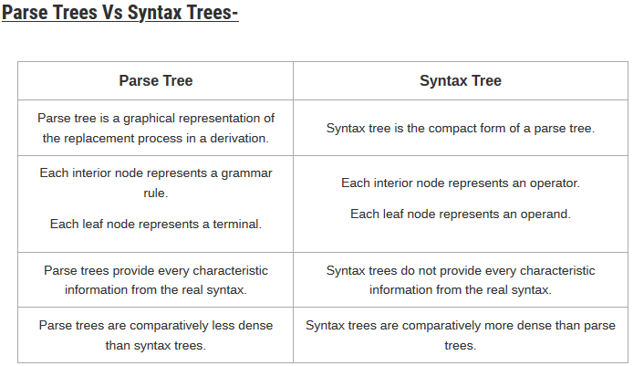

Slide 6
Specification of Programming Languages
PLs require precise definitions (i.e. no ambiguity)
  Language form (Syntax)
  Language meaning (Semantics)
Consequently, PLs are specified using formal notation:
  Formal syntax
    Tokens
    Grammar
  Formal semantics
    Attribute Grammars (static semantics)
    Dynamic Semantics

Slide 7
The Semantic Analyzer
The principal job of the semantic analyzer is to enforce static semantic rules.
In general, anything that requires the compiler to compare things that are separate by a long distance or to count things ends up being a matter of semantics.
The semantic analyzer also commonly constructs a syntax tree (usually first), and much of the information it gathers is needed by the code generator.

Slide 8
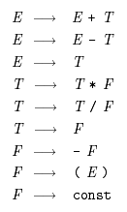
Attribute Grammars
Context-Free Grammars (CFGs) are used to specify the syntax of programming languages
  E.g. arithmetic expressions
How do we tie these rules to mathematical concepts?
Attribute grammars are annotated CFGs in which annotations are used to establish meaning relationships among symbols
  Annotations are also known as decorations

Slide 9
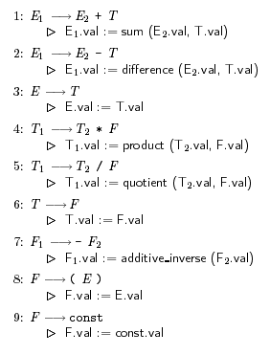
Attribute Grammars
Example
Each grammar symbols has a set of attributes
  E.g. the value of E₁ is the attribute E₁.val
Each grammar rule has a set of rules over the symbol attributes
  Copy rules
  Semantic Function rules
    E.g. sum, quotient
Notes:
Type is another common attribute

Slide 10
Attribute Flow
Context-free grammars are not tied to an specific parsing order
  E.g. Recursive descent, LR parsing
Attribute grammars are not tied to an specific evaluation order
  This evaluation is known as the annotation or decoration of the parse tree

Slide 11
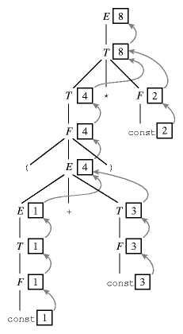
Attribute Flow
Example
The figure shows the result of annotating the parse tree for (1+3)*2
Each symbols has at most one attribute shown in the corresponding box
  Numerical value in this example
  Operator symbols have no value
Arrows represent attribute flow
Notes:
Attribute flow is the pattern in which information moves from one attribute to another

Slide 12
Attribute Flow
Example
Notes:
Attribute flow is the pattern in which information moves from one attribute to another

Slide 13
Attribute Flow
Synthetic and Inherited Attributes
In the previous example, semantic information is pass up the parse tree
  We call this type of attributes are called synthetic attributes
  Attribute grammar with synthetic attributes only are said to be S-attributed
Semantic information can also be passed down the parse tree
  Using inherited attributes
  Attribute grammar with inherited attributes only are said to be non-S-attributed

Slide 14
Attribute Flow
Inherited Attributes
L-attributed grammars, such as the one on the next slide, can still be evaluated in a single left-to-right pass over the input.
Each synthetic attribute of a LHS symbol (by definition of synthetic)depends only on attributes of its RHS symbols.
Each inherited attribute of a RHS symbol (by definition of L-attributed) depends only on inherited attributes of the LHS symbol or on synthetic or inherited attributes of symbols to its left in the RHS.
Top-down grammars generally require non-S-attributed flows
  The previous annotated grammar was an S-attributed LR(1)
  L-attributed grammars are the most general class of attribute grammars that can be evaluated during an LL parse.

Slide 15
Syntax Tree
There is considerable variety in the extent to which parsing, semantic analysis, and intermediate code generation are interleaved.
A one-pass compiler interleaves scanning, parsing, semantic analysis, and code generation in a single traversal of the input.
A common approach interleaves construction of a syntax tree with parsing (eliminating the need to build an explicit parse tree), then follows with separate, sequential phases for semantic analysis and code generation.

Slide 16
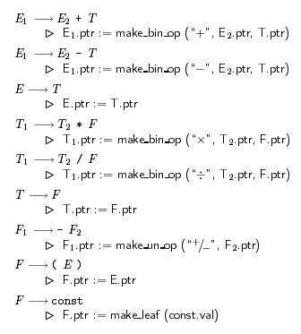
Bottom-up Attribute Grammar to Construct a Syntax Tree

Slide 17
Action Routines
Automatic tools can construct a parser for a given context-free grammar
  E.g. yacc
Automatic tools can construct a semantic analyzer for an attribute grammar
  An ad hoc techniques is to annotate the grammar with executable rules
  These rules are known as action routines

Slide 18
Action Rules
The ease with which rules were incorporated in the grammar is due to the fact that the attribute grammar is L-attributed.
The action rules for L-attributed grammars, in which the attribute flow is depth-first left-to-right, can be evaluated in the order of the parse tree prediction for LL grammars.
Action rules for S-attributed grammars can be incorporated at the end of the right-hand sides of LR grammars. But, if action rules are responsible for a significant part of the semantic analysis, they will need more contextual information to do their job.

